Slide 1
Deep Learning
Batch Normalization
Lec # 4

Slide 2

Why we need Normalization

Slide 3
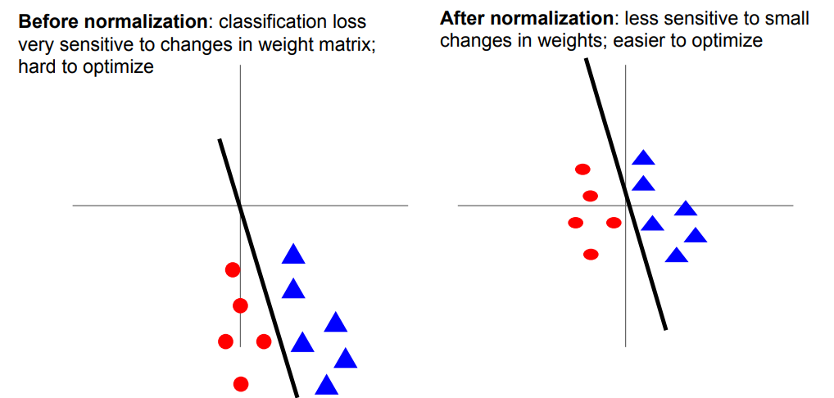

Slide 4
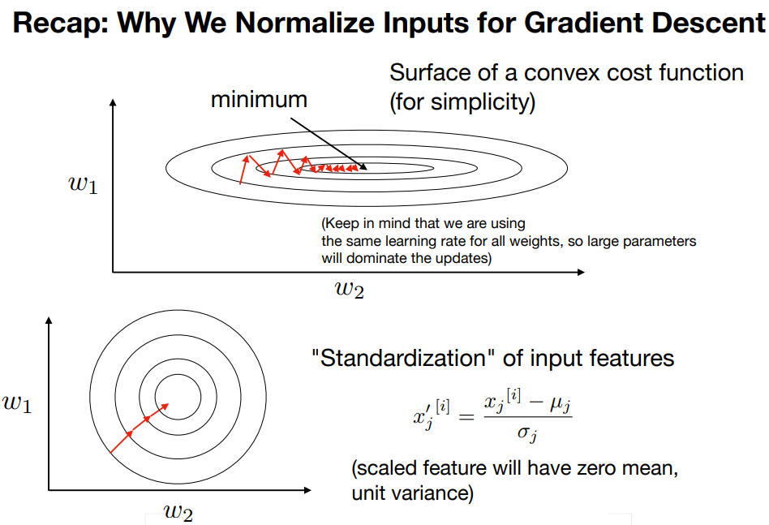

Slide 5

Batch Normalization

Slide 6
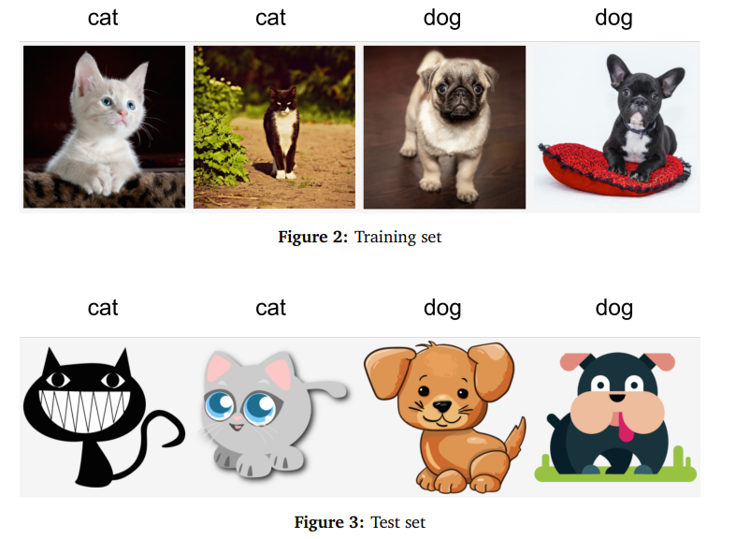
Covariate Shift
Covariate shift is a type of causal (x causes y) distribution shift, which assumes that the distribution of input can change over time, while the labeling function P (y|x) stays the same.

Slide 7
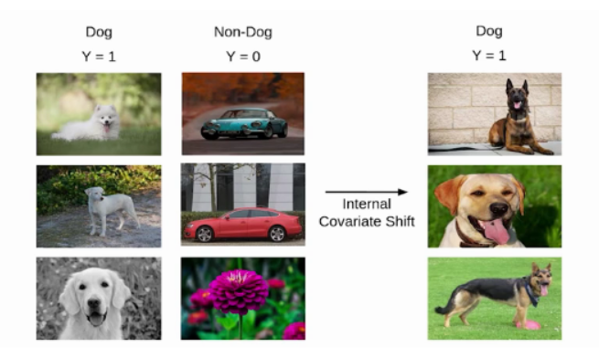

Internal Covariate Shift
“Internal Covariate Shift is the change in the distribution of network activations due to the change in network parameters during training.”

Slide 8
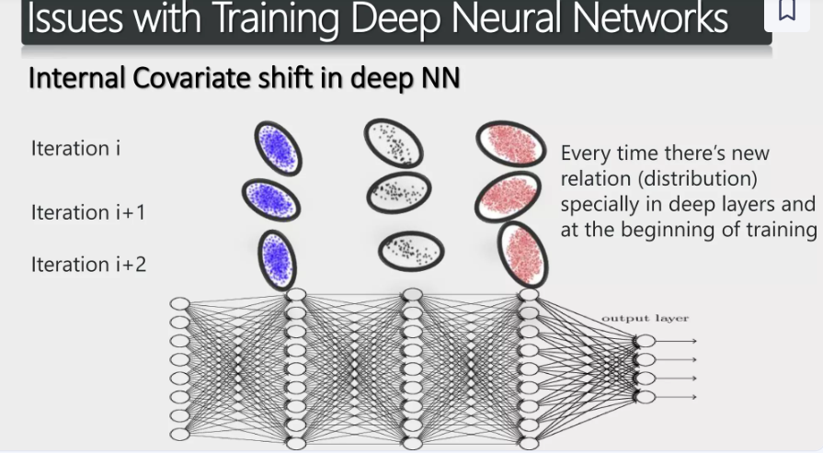

Slide 9
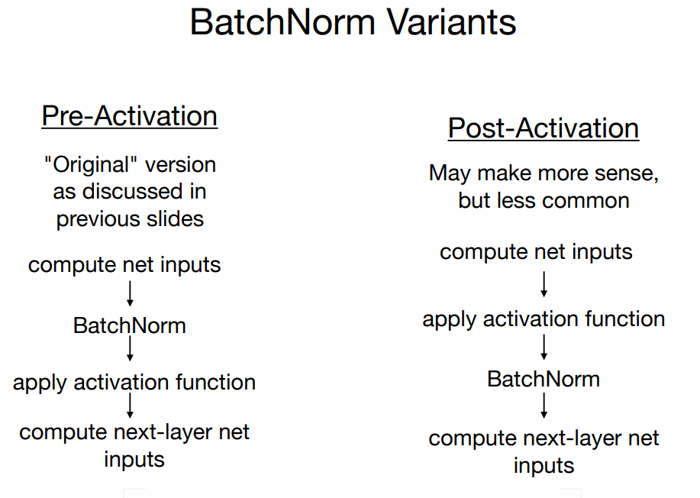

Slide 10
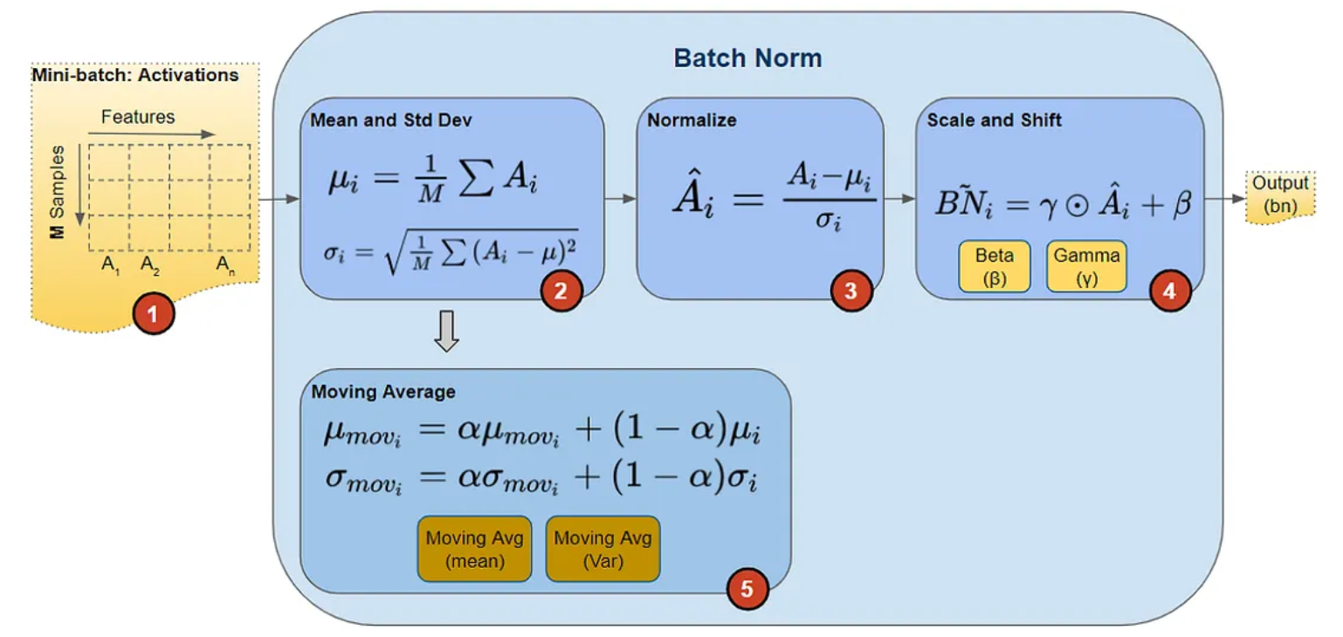

Slide 11
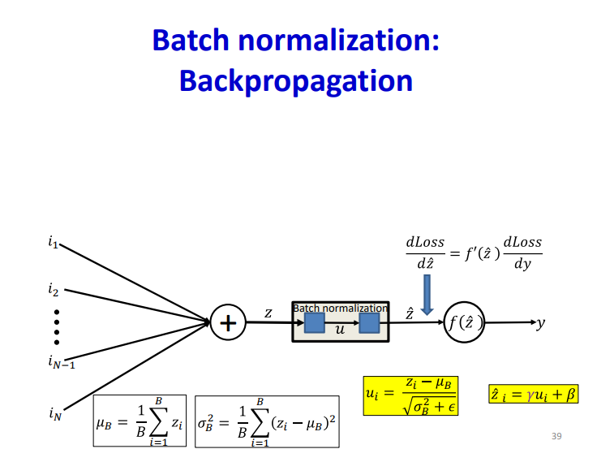

Slide 12
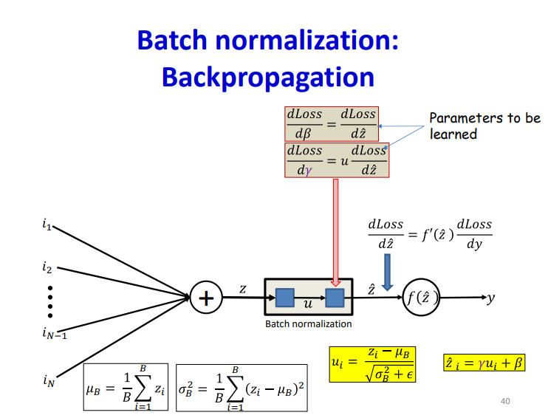

Slide 13
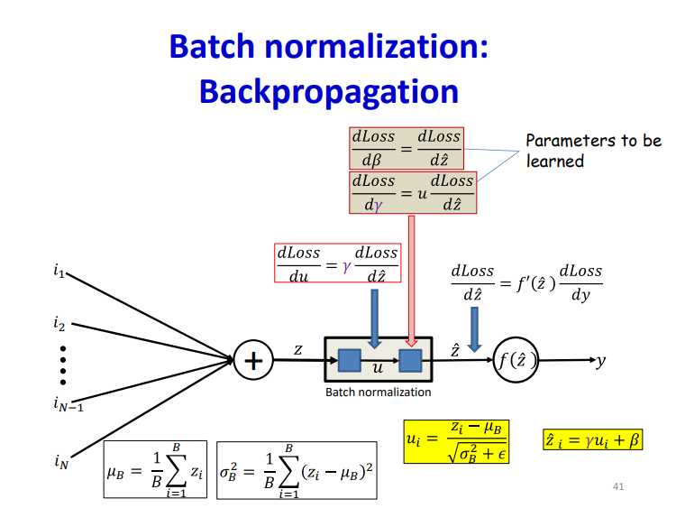

Slide 14
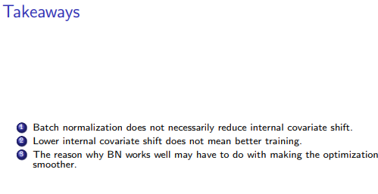

Slide 15
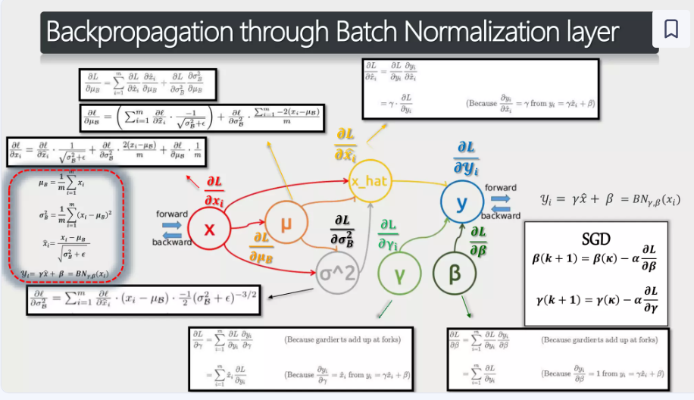

Slide 16
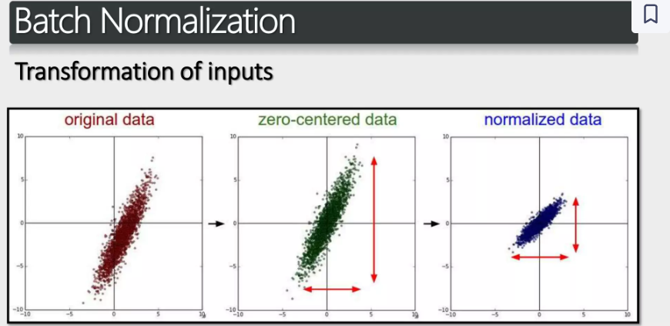

Slide 17
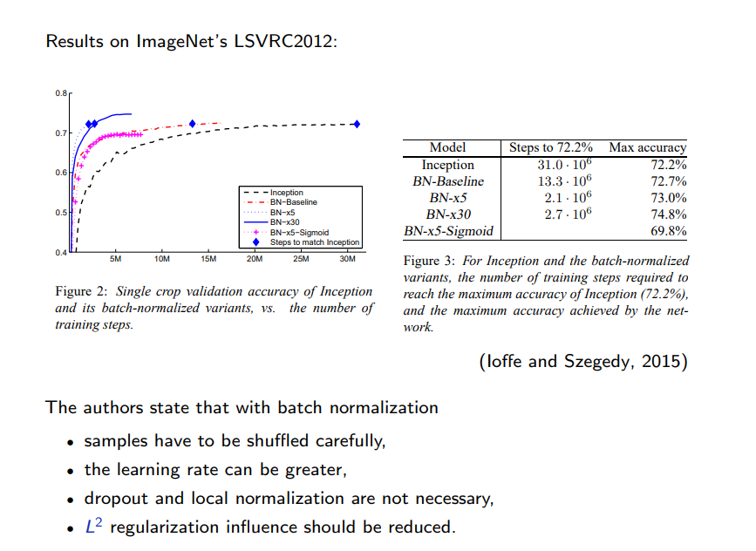

Slide 18
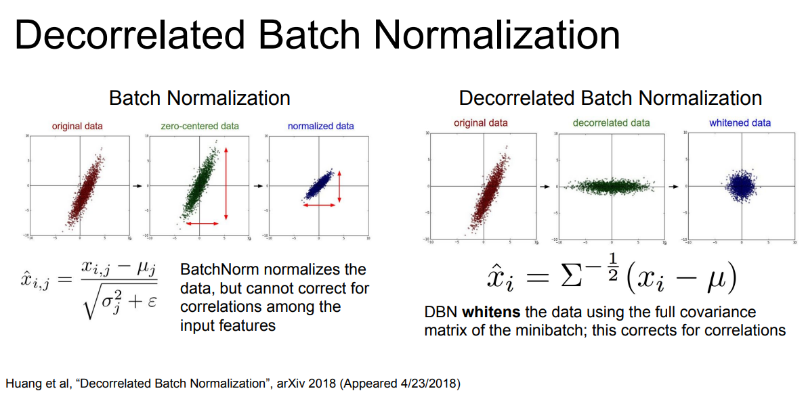

Slide 19
Exponentially Weighted Moving Average
The Exponentially Weighted Moving Average (EWMA) is commonly used as a smoothing technique in time series.
However, due to several computational advantages (fast, low-memory cost), the EWMA is behind the scenes of many optimization algorithms in deep learning, including Gradient Descent with Momentum, RMSprop, Adam, etc.

Slide 20
Reference
https://towardsdatascience.com/batch-norm-explained-visually-how-it-works-and-why-neural-networks-need-it-b18919692739

